Slide 1

Welcome To Expo Students!
Welcome to our expo, students! Get ready to explore our interactive web experience and learn about our amazing team.

Slide 2
Our Amazing Student Development Team
Our team is dedicated to creating the best possible online experience for you. We work together to bring you innovative web applications and engaging content.
We combine our unique skills to develop dynamic webpages that are both visually appealing and easy to use. Get ready to meet our talented individuals!

Slide 3

Introduction to Shapes, Dimensions, and Digital Concepts
This presentation explores fundamental concepts in geometry, data visualization, and digital technology.
Welcome To Expo Students!
Welcome to our expo, students! Get ready to explore our interactive web experience and learn about our amazing team.

Slide 4

Understanding Websites and Webpages: Definitions and Real-world Examples
Website
Webpage
Examples
A collection of interconnected webpages, accessible through a unique domain name.
A single, standalone document on the internet, often part of a larger website.
Facebook, Amazon, Google, Wikipedia.

Slide 5
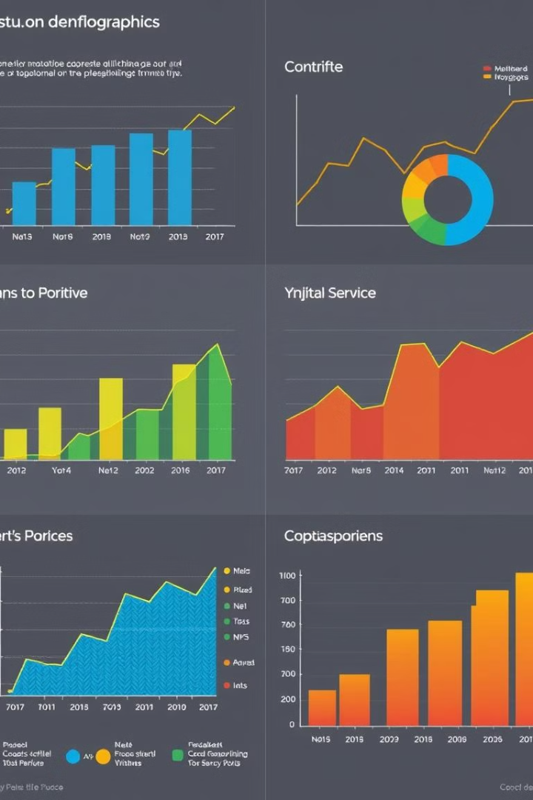
Exploring Data Visualization: Graphs, Charts, and Their Applications
1
Line Graph
Shows trends over time.
2
Bar Graph
Compares discrete categories.
3
Histogram
Represents the frequency of data points.
4
Pie Chart
Illustrates parts of a whole.

Slide 6
Mathematical Functions: Linear and Quadratic Equations
Linear Equation
Quadratic Equation
A straight line, represented by y = mx + c.
A parabola, represented by y = ax² + bx + c.

Slide 7




Two-Dimensional Shapes: Manual Drawing Techniques
Freehand Drawing
Using a pencil and ruler.
Compass and Straightedge
For precise geometric constructions.
Templates and Stencils
To create consistent shapes.

Slide 8
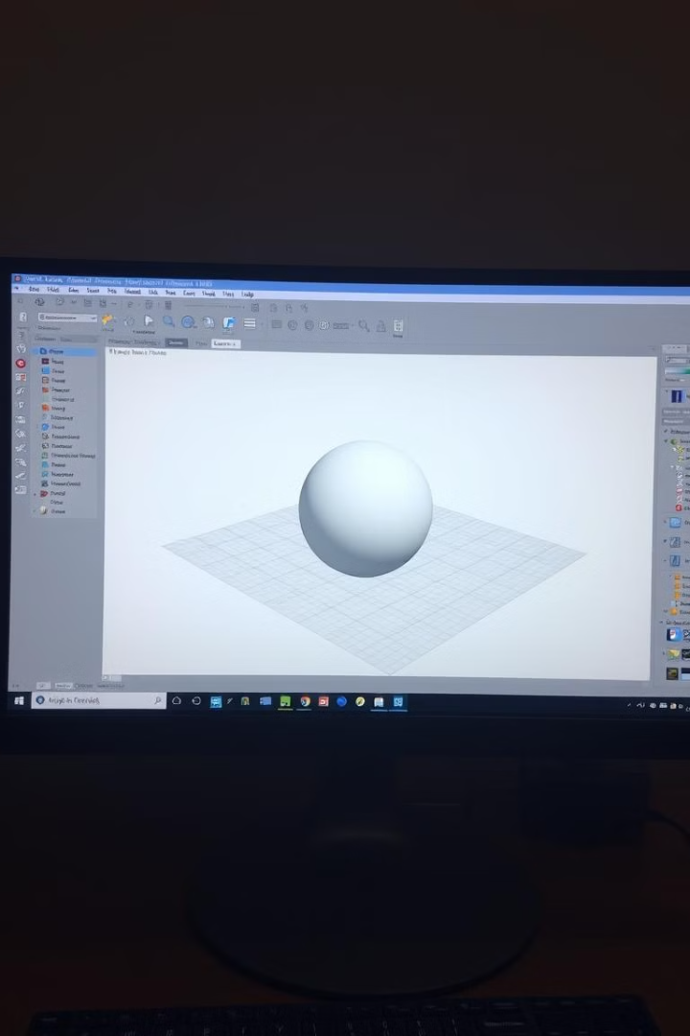
Systematic Approaches to Drawing 2D Shapes
Grid Paper
Helps maintain proportions.
Geometric Software
Provides precise tools and shapes.
Construction Lines
Guides for constructing complex shapes.

Slide 9
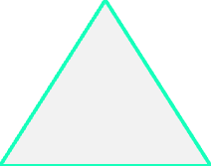
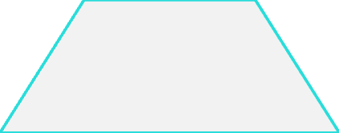
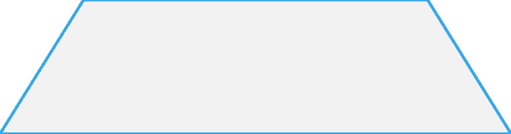
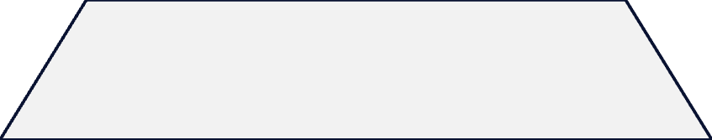
Polynomials: Understanding Complex Mathematical Expressions
Monomial
1
A single term.
Binomial
2
Two terms.
Trinomial
3
Three terms.
Polynomial
4
Many terms.

Slide 10

Ancient Mathematics: The Abacus System and Its Modern Relevance
The abacus is a calculating tool used in ancient civilizations, still relevant in modern education and mathematics. It teaches fundamental arithmetic skills and provides a visual representation of numbers.

Slide 11

Thank You for Joining Us Today!
Thank you for taking the time to learn about our team and our interactive web experience. We hope you enjoyed the expo!

Slide 12


Meet V.Shakthi Ganesh Raja: Front-end Developer
Shakthi is responsible for the visual elements of the website, including the layout, design, and user interface. He ensures that the website is visually appealing and easy to navigate.

Slide 13


Meet K.Aarya: UI/UX Designer
Aarya is responsible for the user experience of the website, including the layout, navigation, and usability. He creates a seamless and engaging user experience.

Slide 14


Meet S.Selva Kumar : Back-end Developer
Selva is responsible for the functionality of the website, including the database, server-side logic, and API integrations. He ensures that the website runs smoothly and efficiently.

